Slide 1
Stochastic Gradient Descent
Jurafsky and Martin Chapter 5

Slide 2
Gradient descent
Notes:
The intuition is that if you are skiing in a canyon and trying to descend most quickly down to the river at the bottom, you might look around yourself 360 degrees, find the direction where the ground is sloping the steepest, and godownhill in that direction.

Slide 3
Stochastic gradient descent algorithm
Notes:
Stochastic gradient descent is an online algorithm that minimizes the loss function by computing its gradient after each training example, and nudging θ in the right direction (the opposite direction of the gradient).
Stochastic gradient descent is called stochastic because it chooses a single random example at a time, moving the weights so as to improve performance on that single example. That can result in very choppy movements, so it’s also common to do minibatch gradient descent, which computes the gradient over batches of train- ing instances rather than a single instance.
The stochastic gradient descent algorithm. Step 1 (computing the loss) is used to report how well we are doing on the current tuple. The algorithm can terminate when it converges (or when the gradient < ε), or when progress halts (for example when the loss starts going up on a held-out set).
The learning rate η is a parameter that must be adjusted. If it’s too high, the learner will take steps that are too large, overshooting the minimum of the loss func- tion. If it’s too low, the learner will take steps that are too small, and take too long to get to the minimum. It is most common to begin the learning rate at a higher value, and then slowly decrease it, so that it is a function of the iteration k of training; you will sometimes see the notation ηk to mean the value of the learning rate at iteration k.

Slide 4
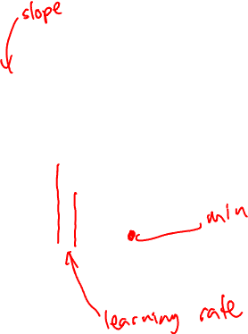
Iteratively find minimum
Notes:
The gradient descent algorithm answers this question by finding the gradient of the loss function at the current point and moving in the opposite direction. The gradient of a function of many variables is a vector pointing in the direction the greatest increase in a function. The gradient is a multi-variable generalization of the slope, so for a function of one variable like the one in Fig. 5.3, we can informally think of the gradient as the slope. The dotted line in Fig. 5.3 shows the slope of this hypothetical loss function at point w = w1. You can see that the slope of this dotted line is negative. Thus to find the minimum, gradient descent tells us to go in the opposite direction: moving w in a positive direction.
The first step in iteratively finding the minimum of this loss function, by moving w in the reverse direction from the slope of the function. Since the slope is negative, we need to move w in a positive direction, to the right. Here superscripts are used for learning steps, so w1 means the initial value of w (which is 0), w2 at the second step, and so on.

Slide 5
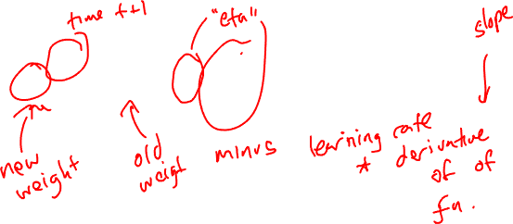
How much should we update the parameter by?
The magnitude of the amount to move in gradient descent is the value of the slope weighted by a learning rate η.
A higher/faster learning rate means that we should move w more on each step.
Notes:
η = eta. Is the learning rate
The change we make in our parameter is the
learning rate times the gradient (or the slope, in our single-variable example)
In each dimension wi, we express the slope as a partial derivative ∂ of the loss ∂wi
function.
The magnitude of the amount to move in gradient descent is the value of the slope d f (x; w) weighted by a learning rate η . A higher (faster) learning rate means that
dw we should move w more on each step. The change we make in our parameter is the
learning rate times the gradient (or the slope, in our single-variable example):

Slide 6
Many dimensions
Notes:
Now let’s extend the intuition from a function of one scalar variable w to many variables, because we don’t just want to move left or right, we want to know where in the N-dimensional space (of the N parameters that make up θ ) we should move. The gradient is just such a vector; it expresses the directional components of the sharpest slope along each of those N dimensions. If we’re just imagining two weight dimension (say for one weight w and one bias b), the gradient might be a vector with two orthogonal components, each of which tells us how much the ground slopes in the w dimension and in the b dimension.
In an actual logistic regression, the parameter vector w is much longer than 1 or 2, since the input feature vector x can be quite long, and we need a weight wi for each xi For each dimension/variable wi in w (plus the bias b), the gradient will have a component that tells us the slope with respect to that variable. Essentially we’re asking: “How much would a small change in that variable wi influence the total loss function L?”

Slide 7
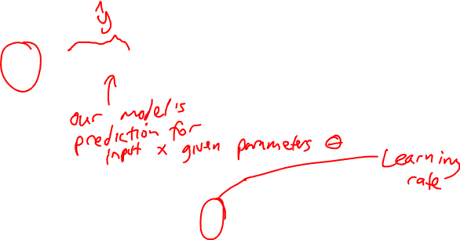
Updating each dimension w_{i}
The final equation for updating θ based on the gradient is
Notes:
In an actual logistic regression, the parameter vector w is much longer than 1 or 2, since the input feature vector x can be quite long, and we need a weight wi for each xi For each dimension/variable wi in w (plus the bias b), the gradient will have a component that tells us the slope with respect to that variable. Essentially we’re asking: “How much would a small change in that variable wi influence the total loss function L?”
In each dimension wi, we express the slope as a partial derivative ∂ of the loss ∂wi
function. The gradient is then defined as a vector of these partials. We’ll represent yˆ as f (x; θ ) to make the dependence on θ more obvious.
∇: Del, or nabla, is an operator used in mathematics, in particular in vector calculus, as a vector differential operator, usually represented by the nabla symbol ∇.

Slide 8
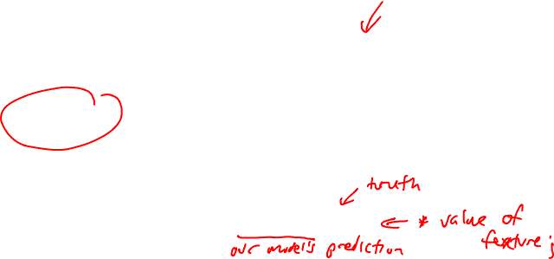
The Gradient
To update θ, we need a definition for the gradient ∇L( f (x; θ ), y).
For logistic regression, the cross-entropy loss function is:
The derivative of this function for one observation vector x for a single weight w_{j} is
The gradient is a very intuitive value: the difference between the true y and our estimate for x, multiplied by the corresponding input value x_{j} .
Notes:
Note in Eq. 5.17 that the gradient with respect to a single weight w j represents a very intuitive value: the difference between the true y and our estimated yˆ = σ (w · x + b) for that observation, multiplied by the corresponding input value x j .

Slide 9
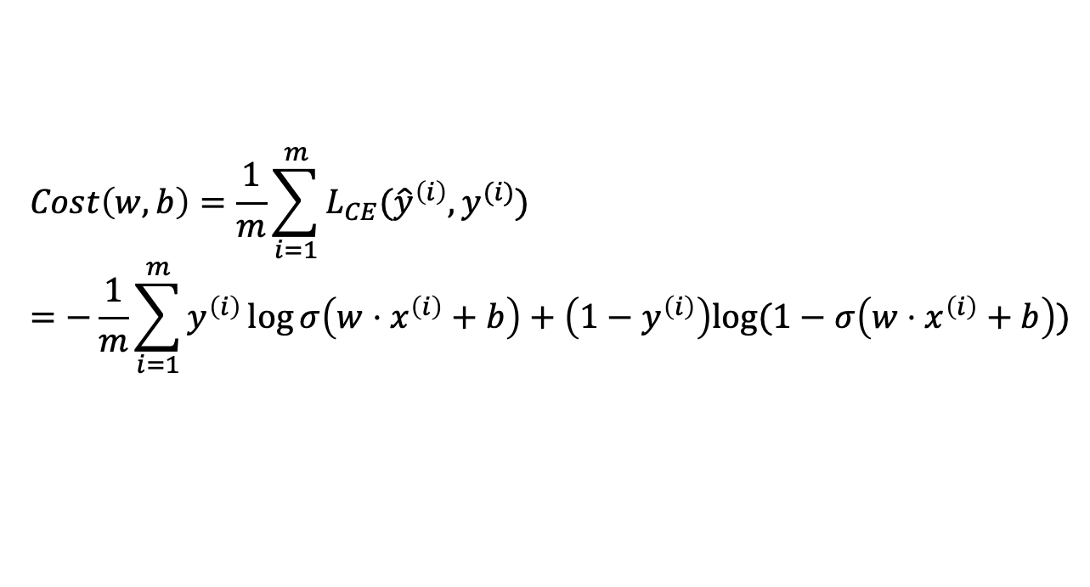
Average Loss
$$Cost\left(w,b\right)=\frac{1}{m}\sum_{i=1}^{m}{L_{CE}({\hat{y}}^{\left(i\right)},y^{(i)}})$$
$$=−\frac{1}{m}\sum_{i=1}^{m}{y^{\left(i\right)}\log{σ\left(w⋅x^{\left(i\right)}+b\right)}+\left(1−y^{\left(i\right)}\right)log⁡(1−σ\left(w⋅x^{\left(i\right)}+b\right))}$$
This is what we want to minimize!!

Slide 10
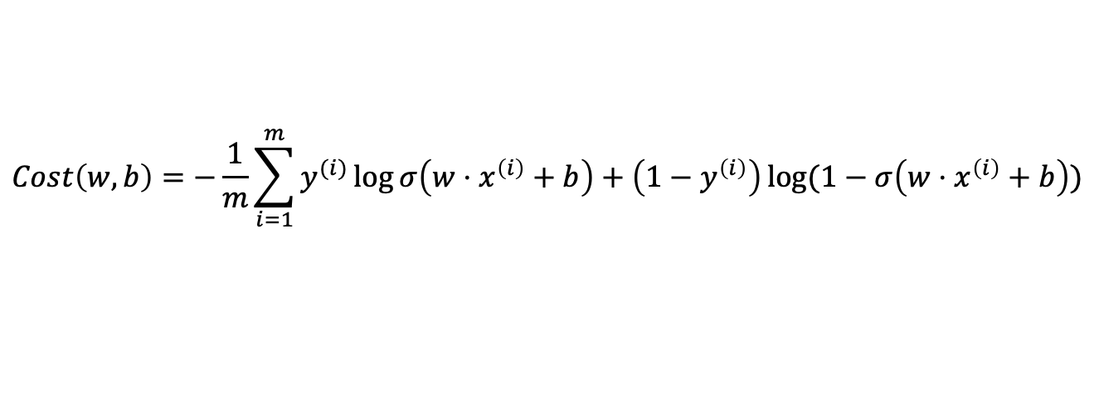
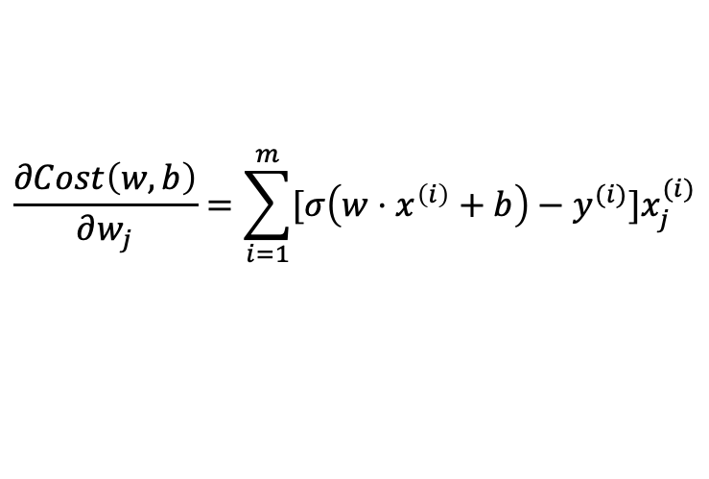
The Gradient
The loss for a batch of data or an entire dataset is just the average loss over the m examples
The gradient for multiple data points is the sum of the individual gradients:
$$Cost\left(w,b\right)=−\frac{1}{m}\sum_{i=1}^{m}{y^{(i)}\log{σ\left(w⋅x^{\left(i\right)}+b\right)+\left(1−y^{\left(i\right)}\right)\log{(1−σ\left(w⋅x^{\left(i\right)}+b\right))}}}$$
$$\frac{∂Cost\left(w,b\right)}{∂w_{j}}=\sum_{i=1}^{m}{[σ\left(w⋅x^{\left(i\right)}+b\right)−y^{(i)}}]x_{j}^{(i)}$$

Slide 11
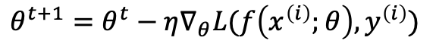
Worked example
Let’s walk though a single step of the gradient descent algorithm. We’ll use a simple sentiment classifier with just 2 features, and 1 training instance where the correct value is y = 1 (this is a positive review).
x₁ = 3 (count of positive lexicon words)
x₂ = 2 (count of positive negative words)
The initial weights and bias in θ⁰ are all set to 0, and the initial learning rate η is 0.1:
w₁ = w₂ = b = 0
η = 0.1
The single update step requires that we compute the gradient, multiplied by the learning rate:
$$θ^{t+1}=θ^{t}−η∇_{θ}L(f\left(x^{\left(i\right)};θ\right),y^{\left(i\right)})$$
Notes:
todo – add the worked example from textbook sectino 5.4.3

Slide 12
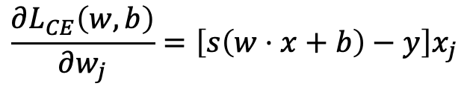
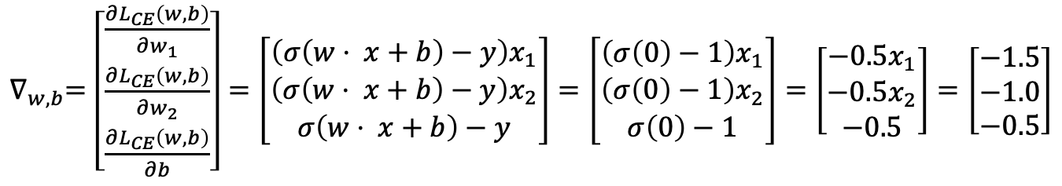
Worked example
The derivative of this function for a single training example x for a single weight w_{j} is
The gradient vector has 3 dimensions, for w₁, w₂, and b. For our input, x₁ = 3 and x₂ = 2
x₂ = 2
$$\frac{∂L_{CE}\left(w,b\right)}{∂w_{j}}=\left[s\left(w⋅x+b\right)−y\right]x_{j}$$
$∇_{w,b}=$ $\left[\begin{matrix}\frac{∂L_{CE}\left(w,b\right)}{∂w_{1}} \\ \frac{∂L_{CE}\left(w,b\right)}{∂w_{2}} \\ \frac{∂L_{CE}\left(w,b\right)}{∂b}\end{matrix}\right]=\left[\begin{matrix}\left(σ\left(w⋅ x+b\right)−y\right)x_{1} \\ \left(σ\left(w⋅ x+b\right)−y\right)x_{2} \\ σ\left(w⋅ x+b\right)−y\end{matrix}\right]=\left[\begin{matrix}\left(σ\left(0\right)−1\right)x_{1} \\ \left(σ\left(0\right)−1\right)x_{2} \\ σ\left(0\right)−1\end{matrix}\right]=\left[\begin{matrix}−0.5x_{1} \\ −0.5x_{2} \\ −0.5\end{matrix}\right]=\left[\begin{matrix}−1.5 \\ −1.0 \\ −0.5\end{matrix}\right]$
Notes:
todo – add the worked example from textbook sectino 5.4.3

Slide 13
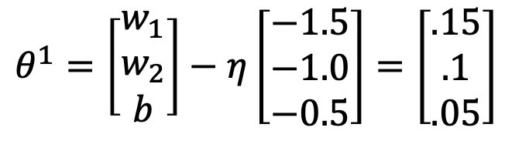
Worked example
Now that we have a gradient ∇_{w,b} , we compute the new parameter vector θ¹ by moving θ⁰ in the opposite direction from the gradient:
So after one step of gradient descent, the weights have shifted to be:
w₁ = 0.15, w₂ = 0.1, and b= .05
$$θ^{1}=\left[\begin{matrix}w_{1} \\ w_{2} \\ b\end{matrix}\right]−η\left[\begin{matrix}−1.5 \\ −1.0 \\ −0.5\end{matrix}\right]=\left[\begin{matrix}.15 \\ .1 \\ .05\end{matrix}\right]$$
Notes:
Note that this observation x happened to be a positive example. We would expect that after seeing more negative examples with high counts of negative words, that the weight w2 would shift to have a negative value.

Slide 14
Mini-batch training
Stochastic gradient descent chooses a single random example at a time and updates its weights on that example. As a result the updates can fluctuate.
An alternate is batch training, which computes the gradient over the entire dataset. This gives a much better estimate of which direction to move the weights but takes a long time to compute.
A commonly used compromise is mini-batch training, where we train on a small batch. The batch size can be 512 or 1024, often selected based on computational resources, so that all examples in the mini-batch can be processed in parallel. The loss is then accumulated.

Slide 15
Logistic Regression – Wrap Up
Jurafsky and Martin Chapter 5

Slide 16
Regularization
Overfitting is a problem with many machine learning models. Overfitting results in poor generalization and poor performance on unseen test set.
In logistic regression, if a feature only occurs in one class then it will get a high weight. Sometimes we are just modelling noisy factors that just accidentally correlate with the class.
Regularization is a way to penalize large weights. A regularization term is added to the loss function.
Lasso regression uses L1 regularization Ridge regression uses L2 regularization
Notes:
There is a problem with learning weights that make the model perfectly match the training data. If a feature is perfectly predictive of the outcome because it happens to only occur in one class, it will be assigned a very high weight. The weights for features will attempt to perfectly fit details of the training set, in fact too perfectly, modeling noisy factors that just accid
entally correlate with the class. This problem is called overfitting.
L1 regularization is a linear function of the weight values, named after the L1 norm, the sum of the absolute values of the weights, or Manhattan distance
L2 regularization is a quadratic function of the weight values, named because it uses the (square of the) L2 norm of the weight values. The L2 norm, ||θ||2, is the same as the Euclidean distance of the vector θ from the origin.
L2 regularization is easier to optimize because of its simple derivative, while L1 regularization is more complex (the derivative is non-continuous at zero).

Slide 17
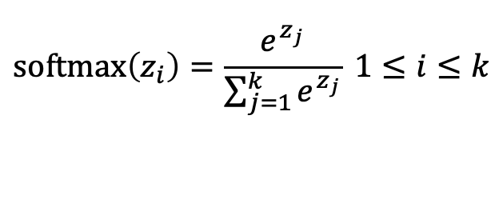
Multinomial logistic regression
Instead of binary classification, we often want more than two classes. For sentiment classification we might extend the class labels to be positive, negative, and neutral.
We want to know the probability of y for each class c ∈ C, p(y = c|x).
To get a proper probability, we will use a generalization of the sigmoid function called the softmax function.
$$\text{softmax}\left(z_{i}\right)=\frac{e^{z_{j}}}{\sum_{j=1}^{k}{e^{z_{j}}}} 1≤i≤k$$
Notes:
In such cases we use multinomial logistic regression, also called softmax re- gression (or, historically, the maxent classifier).
The softmax function takes a vector z = [z1,z2,...,zk] of k arbitrary values and maps them to a probability distribution, with each value in the range (0,1), and all the values summing to 1. Like the sigmoid, it is an exponential function.

Slide 18
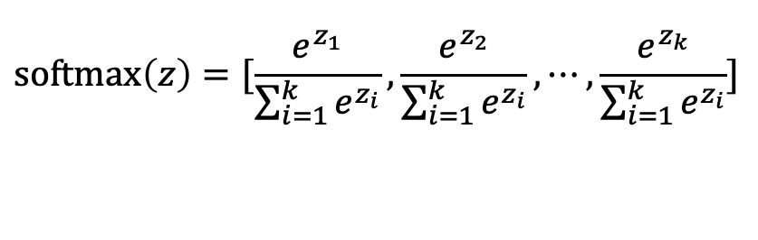
Softmax
The softmax function takes in an input vector z = [z₁,z₂,...,z_{k}] and outputs a vector of values normalized into probabilities.
For example, for this input:
z = [0.6, 1.1, −1.5, 1.2, 3.2, −1.1]
Softmax will output:
[0.056, 0.090, 0.007, 0.099, 0.74, 0.010]
$$\text{softmax}\left(z\right)=[\frac{e^{z_{1}}}{\sum_{i=1}^{k}{e^{z_{i}}}},\frac{e^{z_{2}}}{\sum_{i=1}^{k}{e^{z_{i}}}},⋯,\frac{e^{z_{k}}}{\sum_{i=1}^{k}{e^{z_{i}}}}]$$
Notes:
0.6+1.1 −1.5+1.2+3.2−1.1 = 3.5
0.054+0.090+0.007+0.099+0.74+0.010 = 1

